Slide 1

How many people will apply to the job post in the first hour?

Slide 2

Why this matters?
Job postings on LinkedIn get varying applicant counts depending on posting time
Wanted to know: Does time of day or day of week affect how fast people apply?
Goal: Build a model to predict applicants in the first hour

Slide 3

How to collect the data 🤔
Manually tracked Business Analyst jobs on LinkedIn
Filters used: “Entry Level” + “Last 24 hours”
Modified LinkedIn URL from r86400 → r3600 for hourly tracking
Set hourly phone reminders to check and record applicants

Slide 4

Preparing the dataset
Created Excel sheet with 95 entries
Features: Time, Day of Week, Time Block, Applicants (1hr, 2hr, after 2hr)
Day of week Time Block was converted to numbers (e.g. Sunday = 1…… Saturday = 7) (Morning = 1…. Night = 4)
Imported into RapidMiner

Slide 5
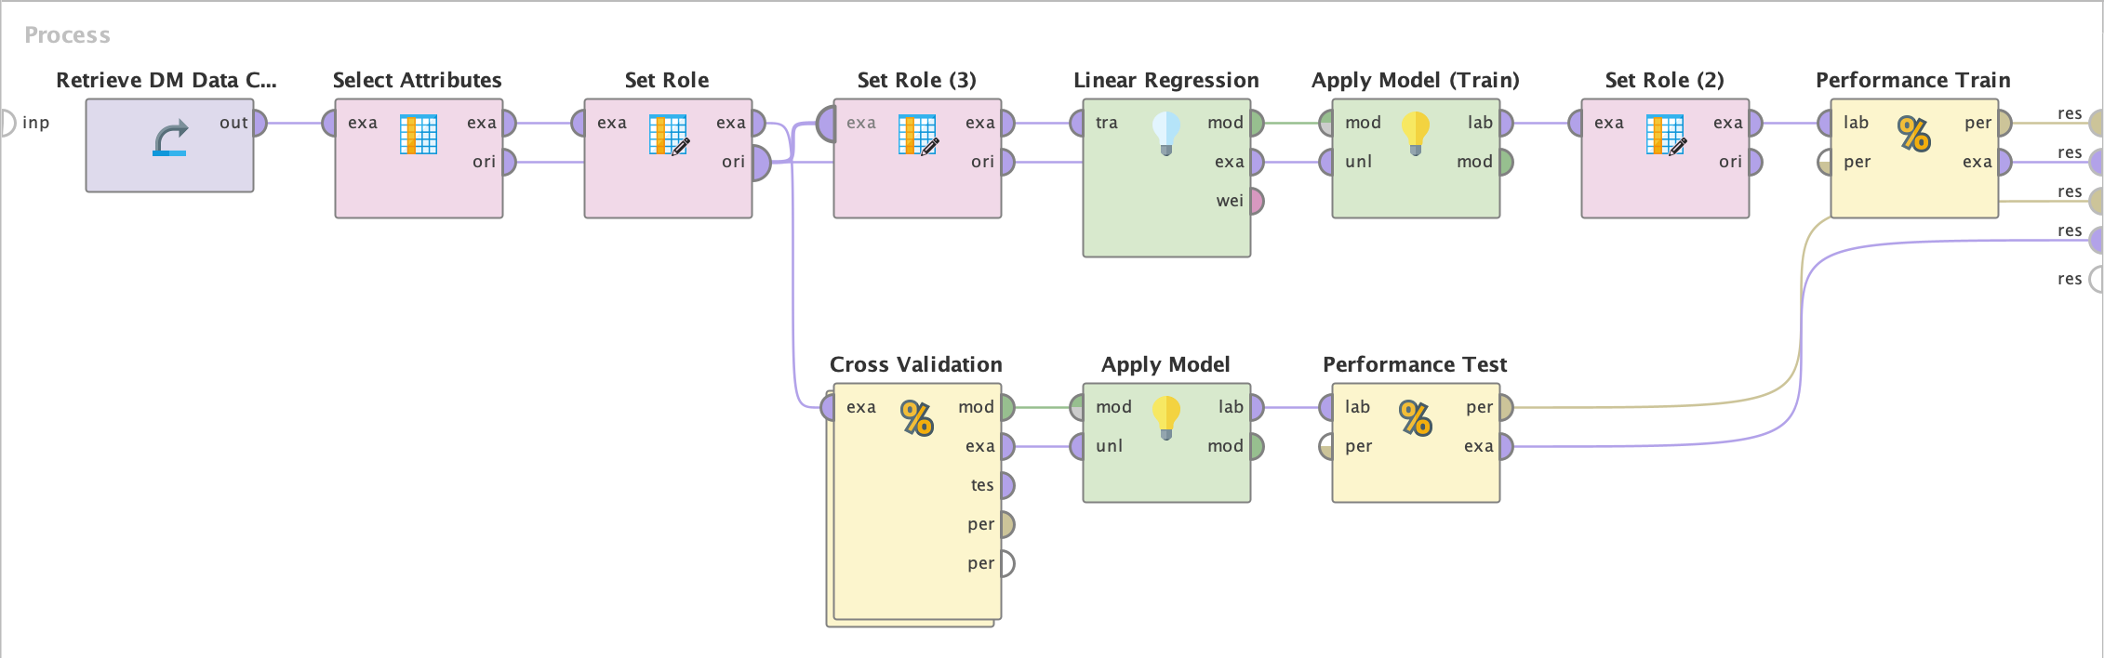
What models did I use?
Used RapidMiner regression techniques: Linear Regression, Ridge Regression, Lasso, & SVR
Used cross-validation to separate data set into training and testing sets

Slide 6
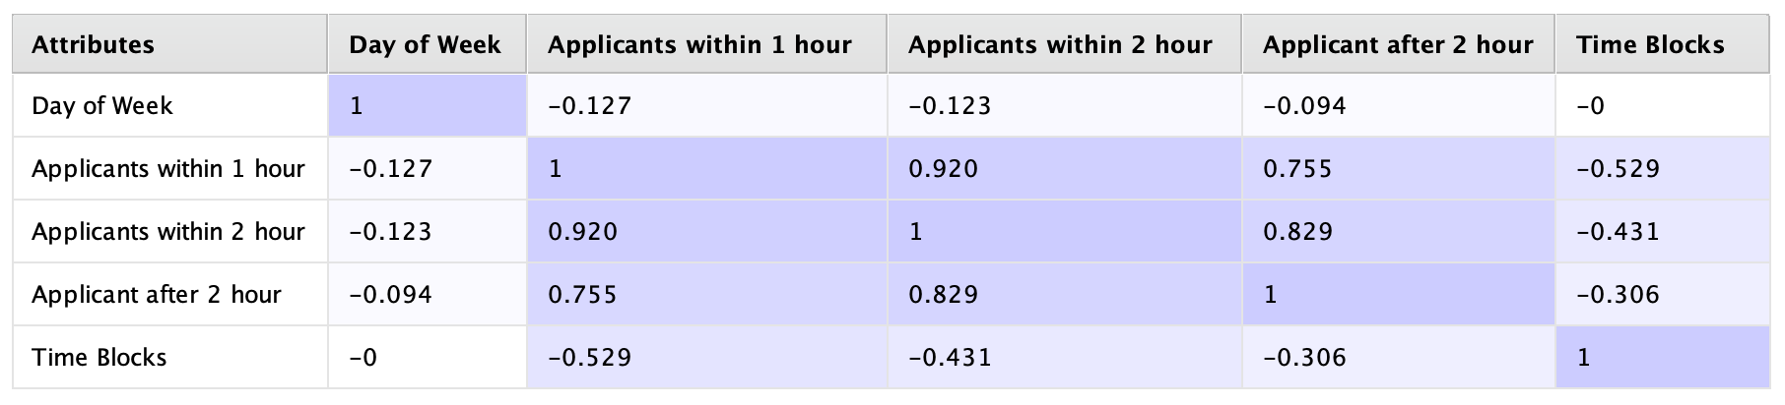
Models Evaluation?
Linear Regression performed best with Test R² of 0.869 and RMSE of 12.829
Later time blocks (e.g., night) see a sharp drop in applicants within the first hour, while the drop in later-hour applicants is smaller—indicating timing matters most for immediate response.
Day of the week has minimal impact on application behavior, meaning job seekers apply consistently regardless of the day.
This model helps applicants by increasing their chances of early visibility and helps job seekers by highlighting the best times to apply with less competition.

Slide 7

Use larger dataset with other job roles
Explore more advanced models
Can also be turned into a job posting optimization tool

Slide 8

Thank You

